Slide 1
Exploratory Data Analysis
Examining Distributions

Slide 2
Data and Variables
Data are pieces of information about individuals organized into variables.
A dataset is a set of data identified with particular circumstances.
Variables can be classified into one of two types: categorical or quantitative.
Categorical variables take category or label values and place an individual into one of several groups. Each observation can be placed in only one category, and the categories are mutually exclusive.
Quantitative variables take numerical values and represent some kind of measurement.

Slide 3
Scales of Measurement/ Types of Variable
The four different scales of measurement, from least to most precise, are
Nominal
Ordinal
Interval
Ratio

Slide 4
Scales of Measurement
The nominal scale of measurement is a qualitative measure that uses discrete categories to describe a characteristic of the research participants.
An ordinal scale of measurement rank-orders participants on some scale or attribute, but the difference between numbers does not convey fixed or equal differences.
The interval scale of measurement takes numerical form, and the distance between pairs of consecutive numbers is assumed to be equal. However, interval variables do not have a meaningful zero point; thus, a zero does not mean the absence of the attribute, but rather it is a particular (but arbitrary) point on the scale.
The ratio scale of measurement is similar to the interval scale. As with the interval scale, a number is assigned to a subject that represents the amount of the attribute that the subject has and the difference between consecutive numbers is assumed to be equal.
Notes:
Nominal: Married, Single, Divorced
Ordinal: Excellent, Good, Fair, Poor
Interval: Temperature
Ratio: Number of children

Slide 5
Examining Distributions
In order to convert these raw data into useful information we need to summarize and then examine the distribution of the variable. By distribution of a variable, we mean:
what values the variable takes, and
how often the variable takes those values.
In order to summarize the distribution of a categorical variable, we first create a table of the different values (categories) the variable takes, how many times each value occurs (count) and, more importantly, how often each value occurs (by converting the counts to percentages); this table is called a frequency distribution.

Slide 6
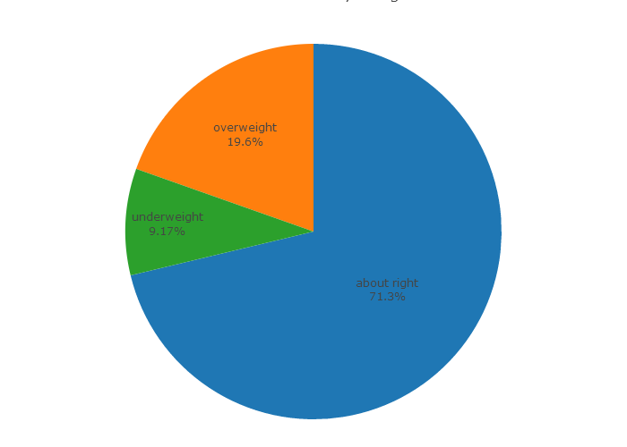
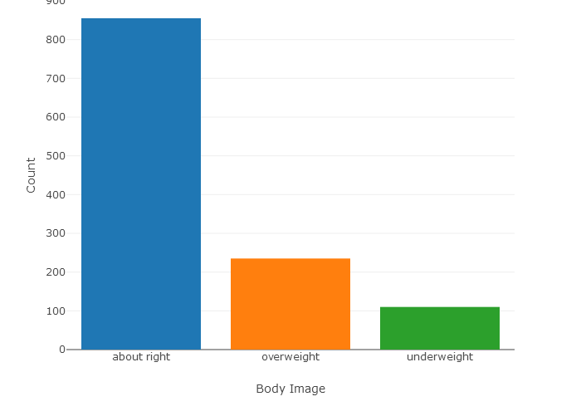
Pie and Bar Charts
In order to visualize the numerical summaries we've obtained, we need a graphical display. There are two simple graphical displays for visualizing the distribution of categorical data:
1. The Pie Chart
2. The Bar Chart

Slide 7
Let's Summarize!
The distribution of a categorical variable is summarized using:
Graphical display: pie chart or bar chart, supplemented by
Numerical summaries: category counts and percentages.

Slide 8
Quantitative Variable: Introduction
Now, we will explore the data collected from a quantitative variable, and learn how to describe and summarize the important features of its distribution. We will first learn how to display the distribution using graphs and then move on to discuss numerical measures.
To display data from one quantitative variable graphically, we can use either the histogram or the boxplot.

Slide 9
Histogram: Intervals (Part-I)
Idea
Break the range of values into intervals and count how many observations fall into each interval
EXAMPLE: EXAM GRADES
Grades of 15 students:
88, 48, 60, 51, 57, 85, 69, 75, 97, 72, 71, 79, 65, 63, 73

Slide 10
Histogram: Intervals (Part-II)
We first need to break the range of values into intervals (also called "bins" or "classes"). In this case, since our dataset consists of exam scores, it will make sense to choose intervals that typically correspond to the range of a letter grade, 10 points wide: 40-50, 50-60, ... 90-100. By counting how many of the 15 observations fall in each of the intervals, we get the following table:
Exam Grades
Score | Count
[40-50) | 1
[50-60) | 2
[60-70) | 4
[70-80) | 5
[80-90) | 2
[90-100] | 1

Slide 11
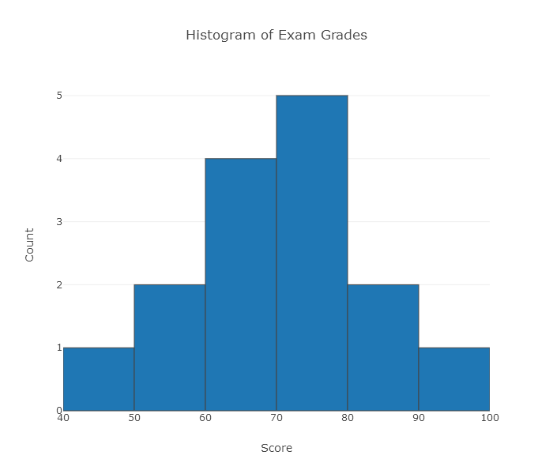
To construct the histogram from this table we plot the intervals on the X-axis, and show the number of observations in each interval (frequency of the interval) on the Y-axis, which is represented by the height of a rectangle located above the interval:

Slide 12
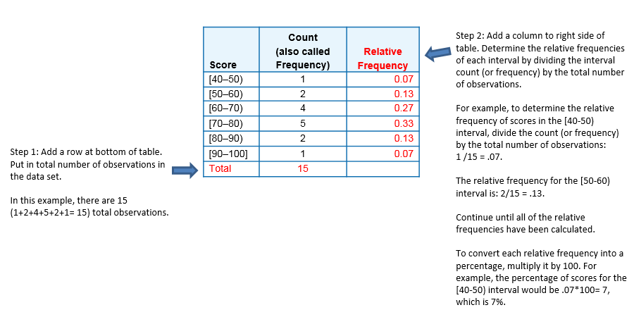
The given table can also be turned into a relative frequency table

Slide 13
Many Students Wonder ...
Question: How do I know what interval width to choose?
Answer: There are no right or wrong choices of interval widths. In this course, we will rely on a statistical package to produce the histogram for us, and we will focus instead on describing and summarizing the distribution as it appears from the histogram.

Slide 14
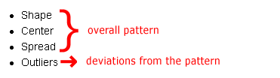
Interpreting the Histogram
Interpreting the Histogram
We will get a sense of the overall pattern of the data from the histogram's center, spread and shape, while outliers will highlight deviations from that pattern.

Slide 15
Shape
When describing the shape of a distribution, we should consider:
1. Symmetry/skewness of the distribution.
2. Peakedness (modality)—the number of peaks (modes) the distribution has.

Slide 16
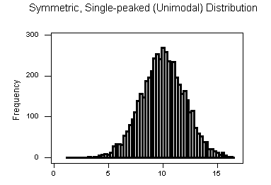
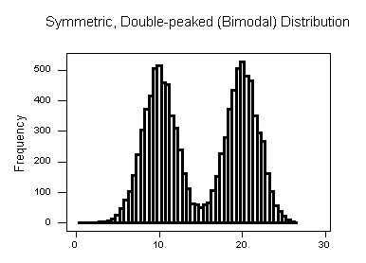
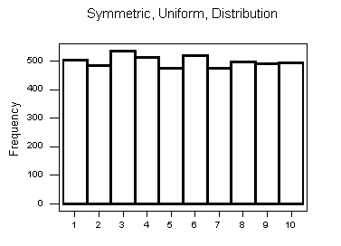
Symmetric Distributions

Slide 17
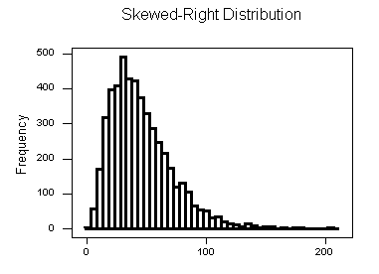
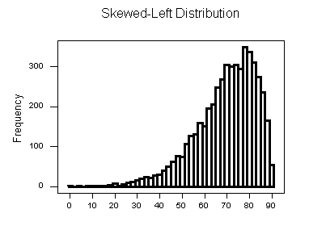
Skewed Right Distributions | Skewed Left Distributions

Slide 18
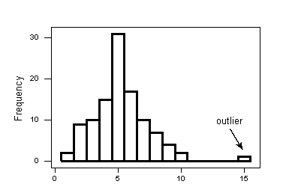
Histogram: Center, Spread, & Outliers
Center
The center of the distribution is its midpoint—the value that divides the distribution so that approximately half the observations take smaller values, and approximately half the observations take larger values.
Spread
The spread (also called variability) of the distribution can be described by the approximate range covered by the data. From looking at the histogram, we can approximate the smallest observation (min), and the largest observation (max), and thus approximate the range.
Outliers
Outliers are observations that fall outside the overall pattern. For example, the given histogram represents a distribution that has a high probable outlier:

Slide 19
Let's Summarize!
The histogram is a graphical display of the distribution of a quantitative variable. It plots the number (count) of observations that fall in intervals of values.
When examining the distribution of a quantitative variable, one should describe the overall pattern of the data (shape, center, spread), and any deviations from the pattern (outliers).
When describing the shape of a distribution, one should consider:
Symmetry/skewness of the distribution
Peakedness (modality)—the number of peaks (modes) the distribution has.
Not all distributions have a simple, recognizable shape.
Outliers are data points that fall outside the overall pattern of the distribution and need further research before continuing the analysis.
It is always important to interpret what the features of the distribution (as they appear in the histogram) mean in the context of the data.

Slide 20
Dotpot
Dotplot
The dotplot shows displays each observation with a dot rather than with its actual value.

Slide 21

Numerical Measures Introduction-I
Intuitively speaking, the numerical measure of center is telling us what is a “typical value” of the distribution.
Mode
The mode is the most commonly occurring value in a distribution
Mean
The mean is the average of a set of observations (i.e., the sum of the observations divided by the number of observations). If the n observations are x₁, x₂, ... , x_{n}, their mean, which we denote by x¯ (and read x¯), is therefore:

Slide 22
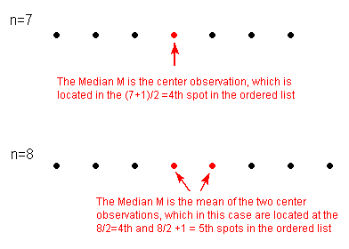
Numerical Measures Introduction-II
Median
The median M is the midpoint of the distribution. It is the number such that half of the observations fall above, and half fall below. To find the median:
Order the data from smallest to largest.
Consider whether n, the number of observations, is even or odd.
If n is odd, the median M is the center observation in the ordered list. This observation is the one "sitting" in the (n + 1) / 2 spot in the ordered list.
If n is even, the median M is the mean of the two center observations in the ordered list. These two observations are the ones "sitting" in the n / 2 and n / 2 + 1 spots in the ordered list.

Slide 23
Comparing the Mean and the Median
The mean describes the center as an average value, in which the actual values of the data points play an important role. The median, on the other hand, locates the middle value as the center, and the order of the data is the key to finding it.
The mean is very sensitive to outliers (because it factors in their magnitude), while the median is resistant to outliers.

Slide 24
Measures of Spread Introduction-I
In order to describe the distribution, we need to supplement the graphical display not only with a measure of center, but also with a measure of the variability (or spread) of the distribution.
In this section, we will discuss the three most commonly used measures of spread:
Range
Inter-quartile range (IQR)
Standard deviation
Like the different measures of center, these measures provide different ways to quantify the variability of the distribution.

Slide 25
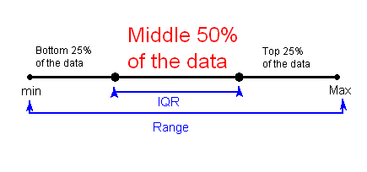
Measures of Spread Introduction-II
Range
The range covered by the data is the most intuitive measure of variability. The range is exactly the distance between the smallest data point (min) and the largest one (Max).
Range = Max – min
Inter-Quartile Range (IQR)
While the range quantifies the variability by looking at the range covered by ALL the data, the IQR measures the variability of a distribution by giving us the range covered by the MIDDLE 50% of the data.

Slide 26
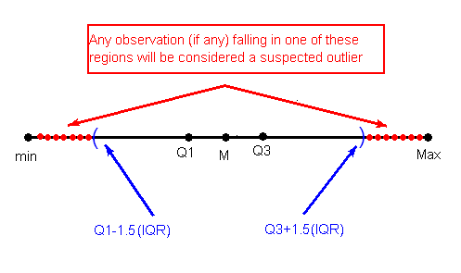
Using the IQR to Detect Outliers
The IQR is used as the basis for a rule of thumb for identifying outliers.
The 1.5(IQR) Criterion for Outliers
An observation is considered a suspected outlier if it is:
below Q1 - 1.5(IQR) or
above Q3 + 1.5(IQR)

Slide 27
Let's Summarize!
The range covered by the data is the most intuitive measure of spread and is exactly the distance between the smallest data point (min) and the largest one (Max).
Another measure of spread is the inter-quartile range (IQR), which is the range covered by the middle 50% of the data.
IQR = Q3 - Q1, the difference between the third and first quartiles. The first quartile (Q1) is the value such that one quarter (25%) of the data points fall below it, or the median of the bottom half of the data. The third quartile(Q3) is the value such that three quarters (75%) of the data points fall below it, or the median of the top half of the data.
The IQR should be used as a measure of spread of a distribution only when the median is used as a measure of center.
The IQR can be used to detect outliers using the 1.5(IQR) criterion. Outliers are observations that fall below Q1 - 1.5(IQR) or above Q3 + 1.5(IQR).

Slide 28
The Five Number Summary
So far, in our discussion about measures of spread, the key players were:
the extremes (min and Max), which provide the range covered by all the data; and
the quartiles (Q1, M and Q3), which together provide the IQR, the range covered by the middle 50% of the data.
The combination of all five numbers (min, Q1, M, Q3, Max) is called the five number summary, and provides a quick numerical description of both the center and spread of a distribution.

Slide 29
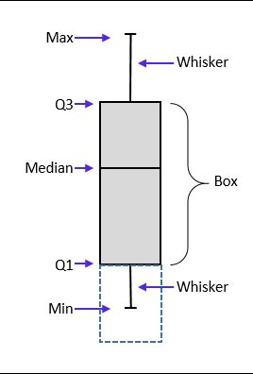
The Boxplot
The boxplot graphically represents the distribution of a quantitative variable by visually displaying the five-number summary and any observation that was classified as a suspected outlier using the 1.5(IQR) criterion.

Slide 30
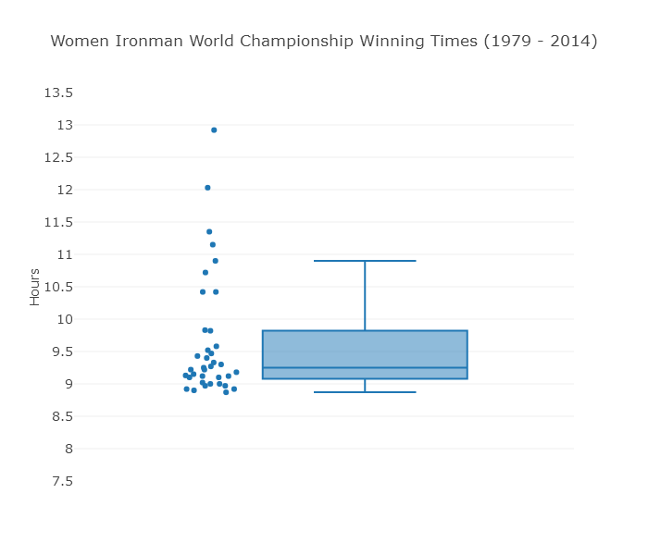
Learn By Doing
1. What percentage of the winners had a time of less than 9.5 hours?
2 What is the IQR of this dataset?
3. Within which interval of times would you expect to find the largest number of winners?
Notes:
The following boxplot displays the winning times for women Ironman champions from 1979 to 2014 (note the race was conducted twice in 1982). You can mouse over the boxplot to see the values of Max, Q3, Median, Q1, and min. Note that in this graph, we have displayed all of the data points (not just the outliers) next to the boxplot.

Slide 31
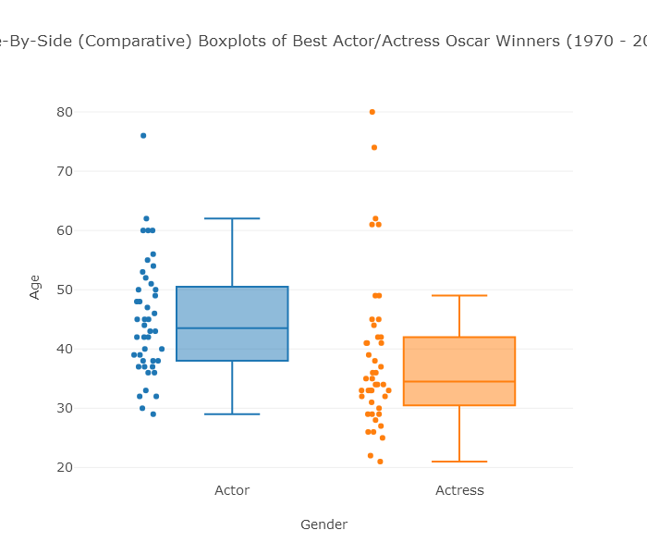
Side-By-Side (Comparative) Boxplots-I
Notes:
Center: The graph reveals that the age distribution of the males is higher than the females' age distribution. This is supported by the numerical measures. The median age for females (34.5) is lower than for the males (43.5). Actually, it should be noted that even the third quartile of the females' distribution (42) is lower than the median age for males. We therefore conclude that in general, actresses win the Best Actress Oscar at a younger age than actors do.
Spread: Judging by the range of the data, there is much more variability in the females' distribution (range = 59) than there is in the males' distribution (range = 47). On the other hand, if we look at the IQR, which measures the variability only among the middle 50% of the distribution, we see slightly more spread in the ages of males (IQR = 12.5) than females (IQR = 11.5). We conclude that among all the winners, the actors' ages are more alike than the actresses' ages. However, the middle 50% of the age distribution of actresses is more homogeneous than the actors' age distribution.
Outliers: We see that we have outliers in both distributions. There is only one high outlier in the actors' distribution (76, Henry Fonda, On Golden Pond), compared with five high outliers in the actresses' distribution.

Slide 32
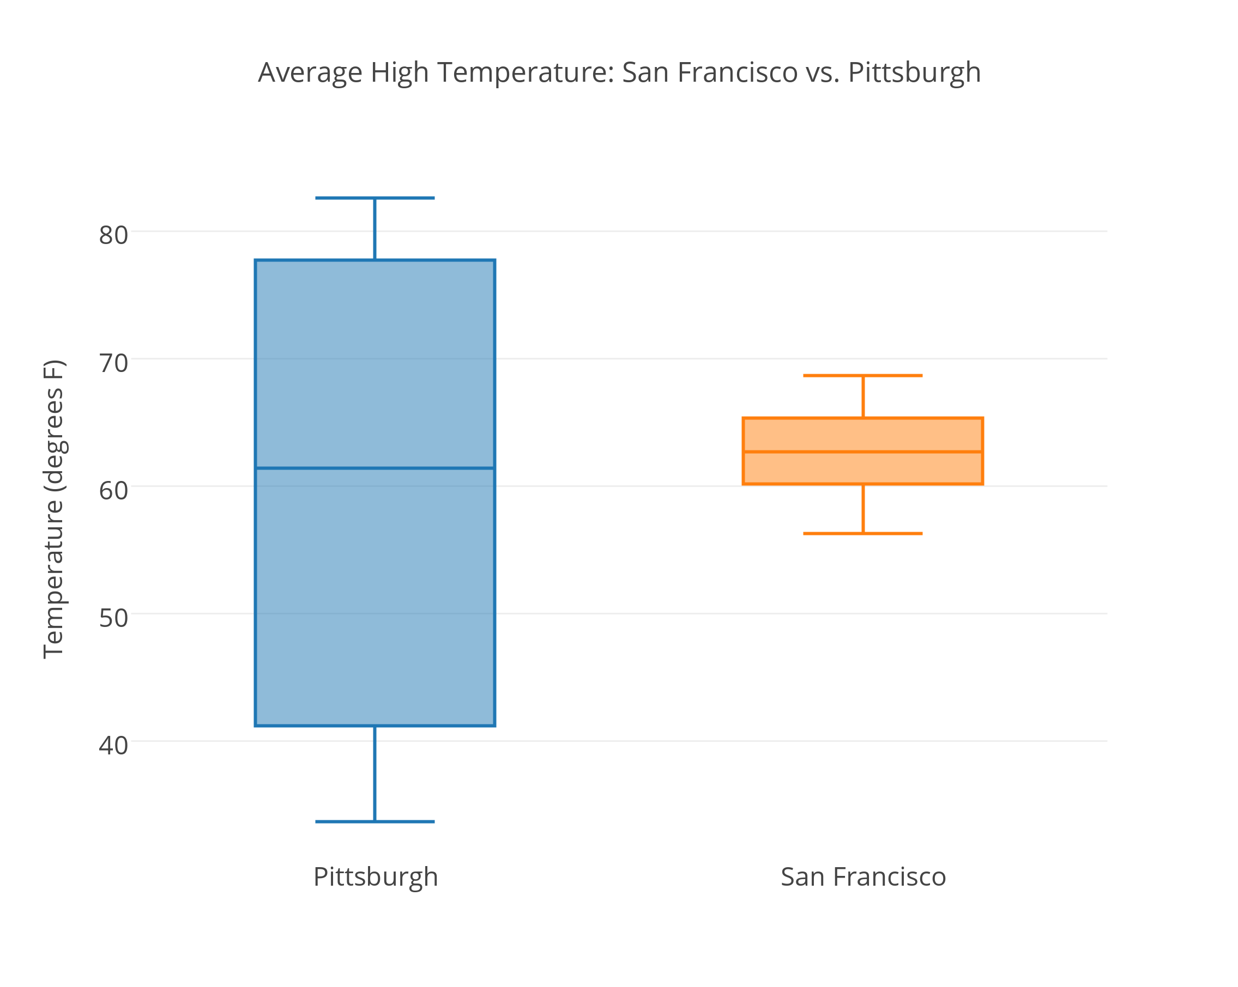
Side-By-Side (Comparative) Boxplots-II
Statistic | San Francisco | Pittsburgh
min | 56.3 | 33.7
Q1 | 60.2 | 41.2
Median | 62.7 | 61.4
Q3 | 65.35 | 77.75
Max | 68.7 | 82.6
Notes:
When looking at the graph, the similarities and differences between the two distributions are striking. Both distributions have roughly the same center (medians are 61.4 for Pitt, and 62.7 for San Francisco). However, the temperatures in Pittsburgh have a much larger variability than the temperatures in San Francisco (Range: 49 vs. 12. IQR: 36.5 vs. 5).
The practical interpretation of the results we got is that the weather in San Francisco is much more consistent than the weather in Pittsburgh, which varies a lot during the year. Also, because the temperatures in San Francisco vary so little during the year, knowing that the median temperature is around 63 is actually very informative. On the other hand, knowing that the median temperature in Pittsburgh is around 61 is practically useless, since temperatures vary so much during the year, and can get much warmer or much colder.
Note that this example provides more intuition about variability by interpreting small variability as consistency, and large variability as lack of consistency. Also, through this example we learned that the center of the distribution is more meaningful as a typical value for the distribution when there is little variability (or, as statisticians say, little "noise") around it. When there is large variability, the center loses its practical meaning as a typical value.

Slide 33
Standard Deviation: Introduction
Idea
The idea behind the standard deviation is to quantify the spread of a distribution by measuring how far the observations are from their mean, x¯. The standard deviation gives the average (or typical distance) between a data point and the mean, x¯.
Notation
There are many notations for the standard deviation: SD, s, Sd, StDev. Here, we'll use SD as an abbreviation for standard deviation, and use s as the symbol.

Slide 34

EXAMPLE: VIDEO STORE CUSTOMERS (I)
The following are the number of customers who entered a video store in 8 consecutive hours:
7, 9, 5, 13, 3, 11, 15, 9
To find the standard deviation of the number of hourly customers:
Find the mean, x¯ of your data:
Find the deviations from the mean: the difference between each observation and the mean:
(7 - 9), (9 - 9), (5 - 9), (13 - 9), (3 - 9), (11 - 9), (15 - 9), (9 - 9)
-2, 0, -4, 4, -6, 2, 6, 0

Slide 35
EXAMPLE: VIDEO STORE CUSTOMERS (II)
Square each of the deviations:
(-2)² = 4, (0)² = 0, (-4)² = 16, and the rest are 16, 36, 4, 36, 0.
Average the square deviations by adding them up, and dividing by n - 1, (one less than the sample size):
The SD of the data is the square root of the variance: SD = 16 = 4
Notes:
This average of the squared deviations is called the variance of the data.
Why do we take the square root? Note that 16 is an average of the squared deviations, and therefore has different units of measurement. In this case 16 is measured in "squared customers," which obviously cannot be interpreted. We therefore take the square root in order to compensate for the fact that we squared our deviations, and in order to go back to the original unit of measurement.
Recall that the average number of customers who enter the store in an hour is 9. The interpretation of SD = 4 is that on average, the actual number of customers that enter the store each hour is 4 away from 9.

Slide 36
Choosing Numerical Summaries
Use x¯ (the mean) and the standard deviation as measures of center and spread only for reasonably symmetric distributions with no outliers.
Use the five-number summary (which gives the median, IQR and range) for all other cases.

Slide 37
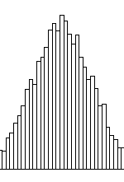
The Standard Deviation Rule
The Standard Deviation Rule:
(For a Normal shaped distribution)
Approximately 68% of the observations fall within 1 standard deviation of the mean.
Approximately 95% of the observations fall within 2 standard deviations of the mean.
Approximately 99.7% (or virtually all) of the observations fall within 3 standard deviations of the mean.

Slide 38
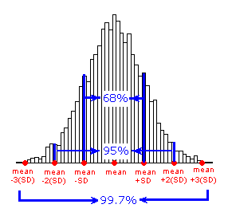
Applications: Male Height Length of Human Pregnancy

Slide 39
Let's Summarize!
The standard deviation measures the spread by reporting a typical (average) distance between the data points and their average.
It is appropriate to use the SD as a measure of spread with the mean as the measure of center.
Since the mean and standard deviations are highly influenced by extreme observations, they should be used as numerical descriptions of the center and spread only for distributions that are roughly symmetric, and have no outliers.
For symmetric mound-shaped distributions, the Standard Deviation Rule tells us what percentage of the observations falls within 1, 2, and 3 standard deviations of the mean, and thus provides another way to interpret the standard deviation's value for distributions of this type.

Slide 40
Wrap-Up
You've seen how, by using graphs and numbers, we can bring to light all the information that is stored in the data about the variable of interest. Another important point is that graphs and numbers are powerful only when accompanied by their interpretation in the context of the problem.

